Slide 1
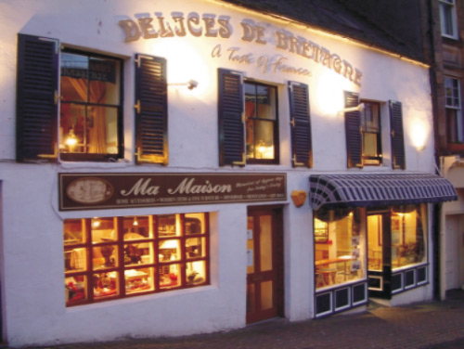
RESTAURANT

Slide 2
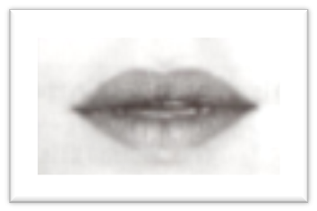
R R is a consonant
To make the Sound
[R]
Raise the back of your tongue close to the back of the throat and make a gargling sound. The sound is made with the vocal cords

Slide 3
[R]: Restaurant
It is not really a rolled sound
Gargled sound like the ch is Scottish loch
The Scottish ch sound is not voiced like the French r
Radio
Réserver
Riche

Slide 4
[R]: Restaurant
It keeps the same quality in the middle of words
Restaurant
Sourire
Vendre
A final r is normally pronounced
Car (because)
Hiver (winter)
Sur (on)
Sortir (to go out)

Slide 5
[R]: Restaurant
EXCEPTION
The final R is not sounded at the end of er verbs
Parler (to speak)
Manger(to eat)
In –ier endings:
premier (first),
Janvier(January)
Papier(paper)

