Slide 1
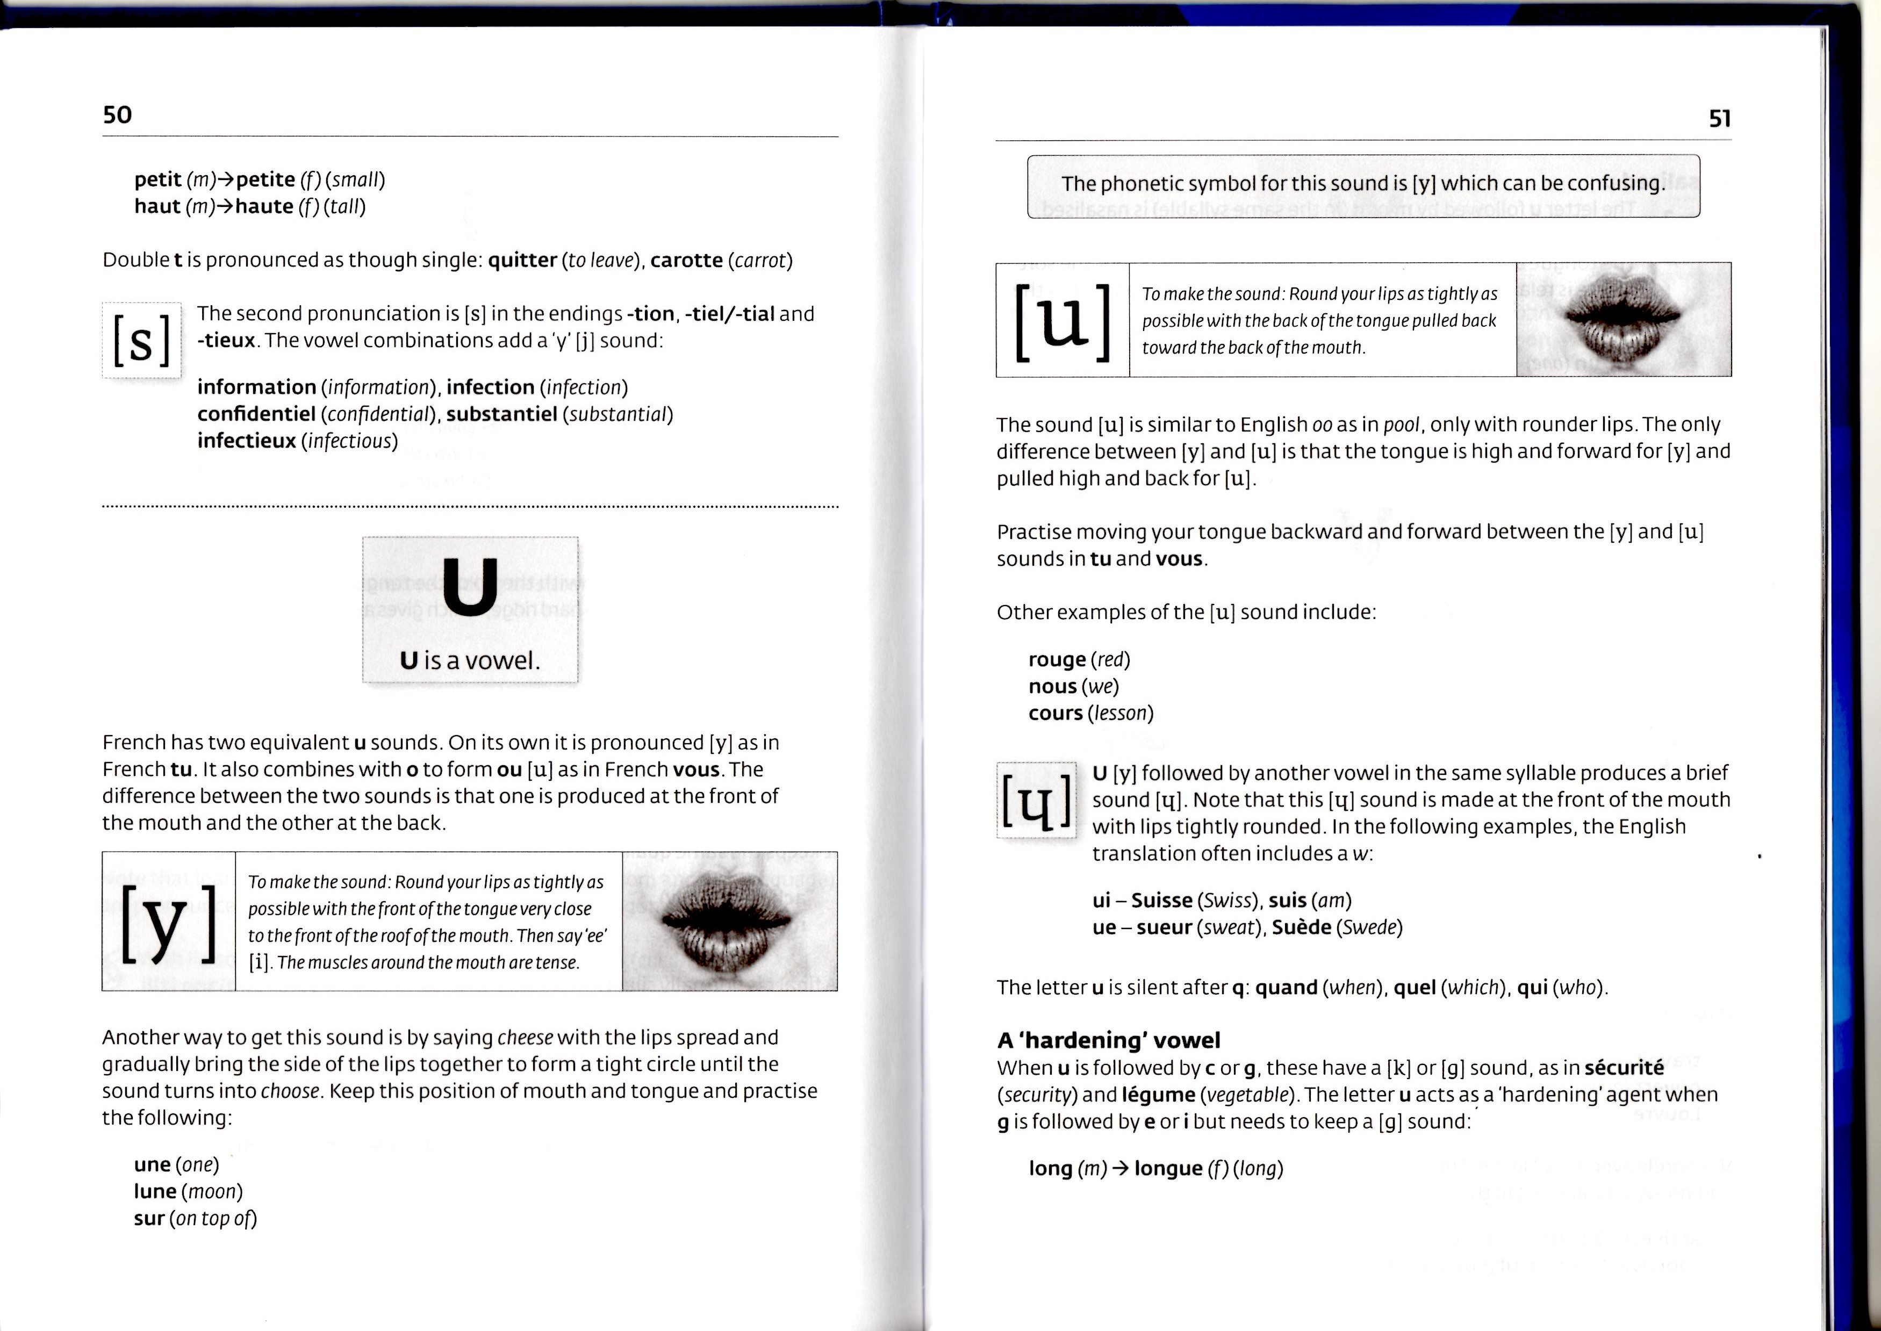

Slide 4
LE U SON
The u sound does not exist in English
Here is a trick
  Say ee with the tip of your tongue against your front bottom teeth.
  Then keeping your tongue against your bottom teeth, round your lips.
  The sound coming out of your mouth is the French ew.
  Salut

