Slide 1
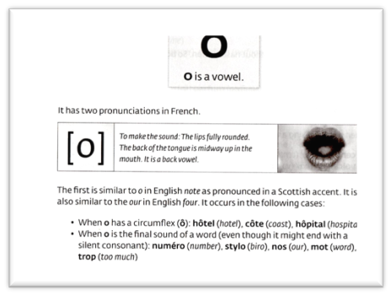
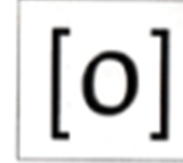
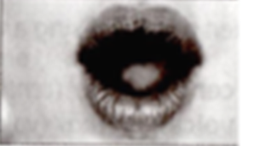
It has two pronunciations in French
To make the first sound the lips are fully rounded.
The back of the tongue is midway up in the mouth. It is a back vowel.
The first is similar to the word note in English as pronounced in a Scottish accent. It is also similar to the our in English four. It occurs in the following cases.
When O has a circumflex ô hôtel (m, hotel), côte (f coast), hôpital (hospital).
When O is the final sound of a word (even though it might end with a consonant
Numéro (number); stylo (pen); nos (ours); trop (too much).
The letter combination au has the same o sound as in beaux(beautiful), au (to) eau = water

Slide 2
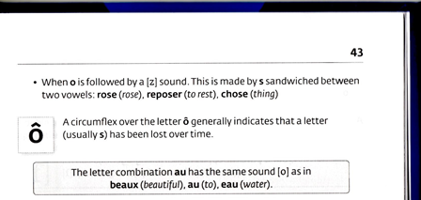
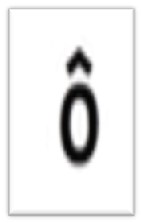
When o is followed by a [z] sound. This is made by s sandwiched between two vowels rose(rose), reposer(to rest), chose (thing).
A circumflex over the letter generally indicates that a letter (usually s) has been lost over time.
The letter combination au has the same sound of [o] as in beaux (beautiful), au(to) and eau (water).

Slide 3
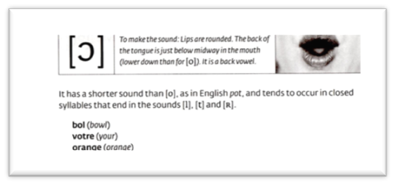
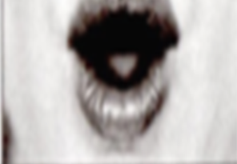
To make the second sound: The lips are rounded. The back of the tongue is just below midway in the mouth, lower down than for [o]. It is a back vowel.
It has a shorter sound than [o] as in English pot, and tends to occur in closed syllables that end in the sounds [l], [t], [r].
Bol (m bowl), Votre (yours), Orange (m orange).

Slide 4
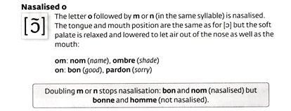
O>M et O>N the O is nasalised
THERE IS NO NASALISATION WHEN N or M IS DOUBLED - Bonne

Slide 5
Summary/en résumé(2 sons)
French | Symbol | As in English | French word | Pronunciation | Meaning
o | Oh | Boat | Le mot | Luh moh | word
ô | Oh | boat | Les côtes | Ley côtes | ribs
Au | Oh | boat | Aujourd’hui | Oh-zhoohr-dwee | today
Aux | Oh | boat | chapeaux | Shah-poh | hat
Eau | Oh | boat | Eau | loh | water
Eaux | Oh | boat | Eaux | bâteaux | Bah-toh
o | ohh | pot | bol | Luh bol | apple
o | ohh | votre | your | votre | apple
o | ohh | orange | orange | orange | boots

Slide 6
OU/OI/OY
French | Symbol | As in English | French word | Pronunciation | Meaning
ou | ooh | you | L’amour | Lah-moohr | love
où | ooh | you | où | ooh | where
French | Symbol | As in English | French word | Pronunciation | Meaning
oi | wah | watch | La soie | (lah swah) | silk
oy | wah | watch | moyen | (mwah-yaN | average

